Slide 1



SUNSTONE
“ E-Commerce Web Application ”
Task - 1

Slide 2

SUNSTONE
Project Name : “ E-Commerce Web Applicatiofi ”
An e-commerce website is one that allows people to buy and sell physical goods, services, and digital products over the internet rather than at a brick-and-mortar location. Through an e-commerce website, a business can process orders, accept payments, manage shipping and logistics, and provide customer service.
S.NO | LMS Username | Name | Batch
1 | @Adhulya1 | Adhulya Mishra | 10
2 | @Gokul1234gk | Gokul | 10
3 | @Kumaravel1230 | Kumaravel | 10
4 | @Pushparaj236 | Pushparaj | 10

Slide 3
SUNSTONE
Task-1
Creatiofi of SRS afid Github
Create SRS : “ E-Commerce Web Application ”
Creation & A Set-up of Github account
Creation & Hands – on to various commands of Git Bash
Evaluatiofi Metric:
100% Completion of the above tasks
Learfiifig Outcome
Get to know about different lifesycle models.
Understanding importance and how to create an SRS.
Knowing varous commands of Github.
Understanding agile and scrum management techniques for efficient for product development.

Slide 4
SUNSTONE
Step-Wise Descriptiofi
Write for your audience.
Include all relevant information.
Add value with benefits.
Make it scannable.
Use relevant keywords.
Include rich media.
Convince with social proof.
Tell mini stories
Summary of your task
The purpose of the project is to build an application program to reduce the manual work for managing the Clothes, Item Category, Delivery Address, and Shopping Cart. It tracks all the details about the Shopping Cart, Customer, Order.

Slide 5
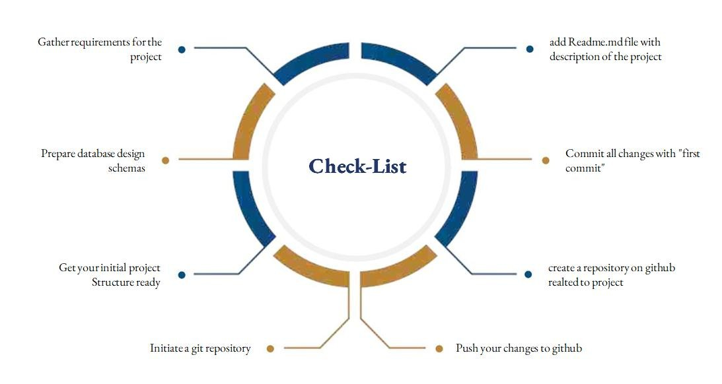
SUNSTONE
Assesment Parameter

Slide 6
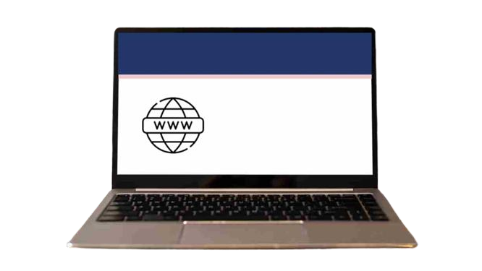
Submission Github
SUNSTONE
https://github.com/Gokul1234gk/NM-AIT-GROUP10

Slide 7


SUNSTONE

